Slide 1


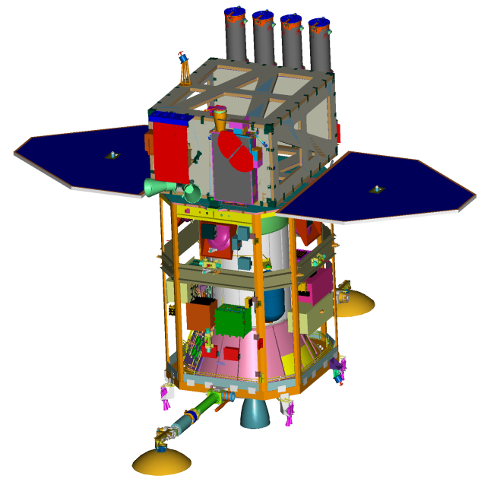
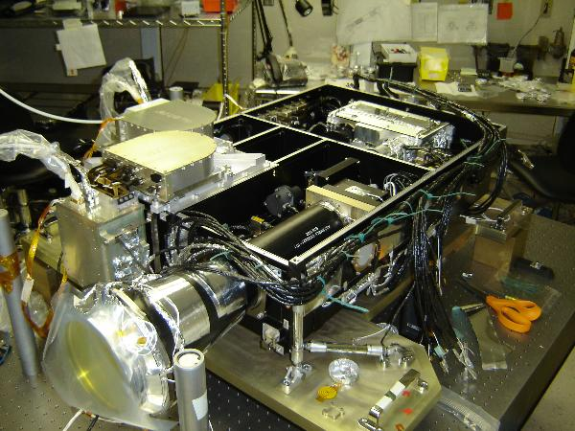
History / Background / Prior missions
The need for an instrument like HMI was recognized in 1996 with the conceptual design developed in 1998. The SDO mission definition study in 2001 clarified the requirements, with real work on HMI beginning after a competitive selection process in 2002. The Helioseismic and Magnetic Imager is a new and improved version of the Michelson Doppler Imager (MDI) instrument on the Solar and Heliospheric Observatory (SOHO). SOHO is a joint project of the European Space Agency and NASA. MDI was developed starting in 1988 by the same collaboration between Stanford and Lockheed teams that developed HMI. SOHO was launched in December 1995. SOHO/MDI is presently still operating well and has completed helioseismic and magnetic field observation of the Sun for all of solar cycle 23 and the beginning of cycle 24. HMI will continue these important measurements from space into the next solar cycle. We hope and anticipate that SDO/HMI will enable deeper understanding of solar processes during most of solar cycle 24.
SDO web link: http://sdo.gsfc.nasa.gov
HMI web link: http://hmi.stanford.edu
HMI/AIA JSOC data center web link: http://jsoc.stanford.edu
Helioseismic & Magnetic Imager
Solar Dynamics Observatory
The HMI Team: Stanford University, Lockheed-Martin Solar and Astrophysics Laboratory, High Altitude Observatory, and 22 Co-Investigator Institutions
HMI Major Science Goals
HMI Implementation
The HMI instrument design and observing strategy are based on the highly successful MDI instrument, with several important improvements. HMI will observe the full solar disk in the Fe I absorption line at 6173Å with a resolution of 1 arc-second. HMI consists of a refracting telescope, a polarization selector, an image stabilization system, a narrow band tunable filter and two 4096² pixel CCD cameras with mechanical shutters and control electronics. The continuous data rate is 55Mbits/s.
Images are made in a sequence of tuning and polarizations at a 4-second cadence for each camera. One camera is dedicated to a 45s Doppler and line-of-sight field sequence while the other to a 90s vector field sequence. All of the images are downlinked for processing at the HMI/AIA Joint Science Operations Center at Stanford University.
SDO and HMI
HMI Optics Package
HMI Electronics Box
*Co-Investigator, **Principal Investigator, HEPL: W.W. Hansen Experimental Physics Laboratory; LMSAL: Lockheed-Martin Solar and Astrophysics Laboratory; HAO: High Altitude Observatory; JPL: Jet Propulsion Laboratory; NJIT,BBSO: New Jersey Institute of Technology, Big Bear Solar Observatory; CoRA: Colorado Research Associates; NSO: National Solar Observatory; SAO: Smithsonian Astrophysical Observatory; UMCP: University of Maryland College Park; ESA: European Space Agency; IIAP: Indian Institute of Astrophysics; MPS: Max Planck Institute for Solar System Research; MSSL: Mullard Space Science Laboratory; NAOJ: National Astrophysical Observatory of Japan; RAL: Rutherford Appleton Laboratory. †Deceased.
The Solar Dynamics Observatory will be placed into an inclined geosynchronous orbit to maximize sunlit hours while providing high bandwidth telemetry. Launch is scheduled for February 2010.

Slide 2
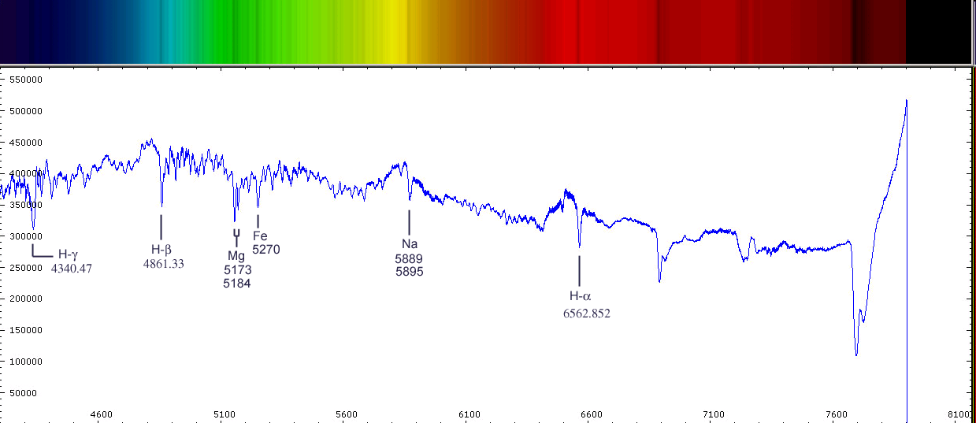
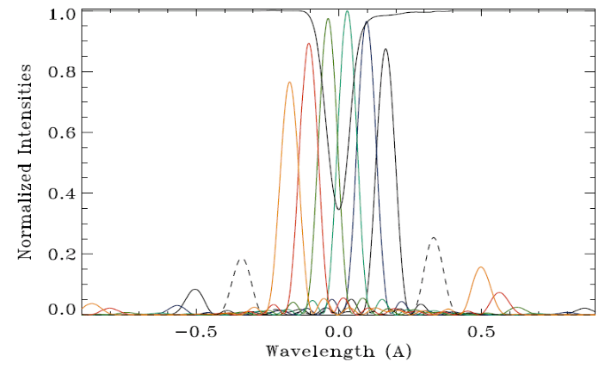
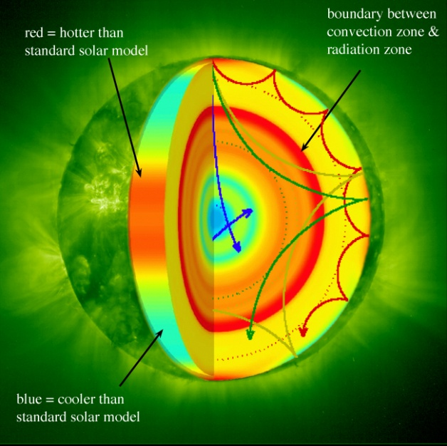
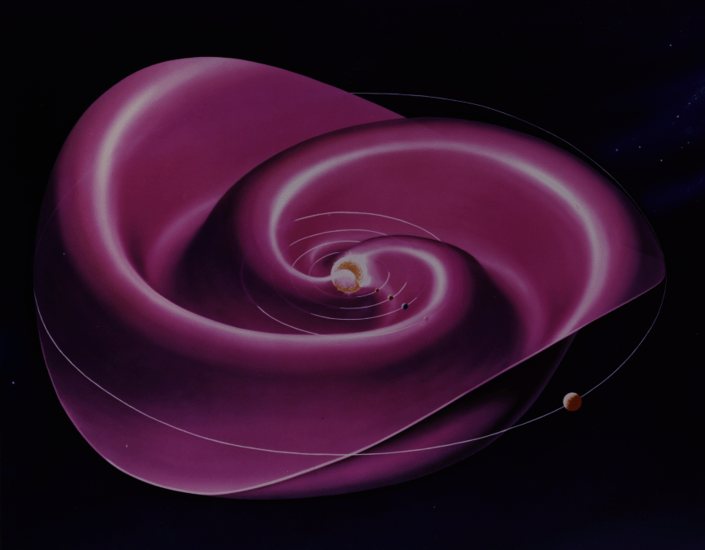
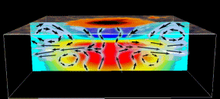
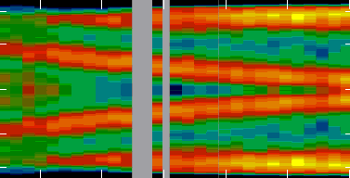
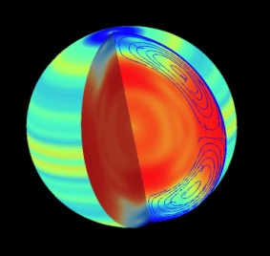
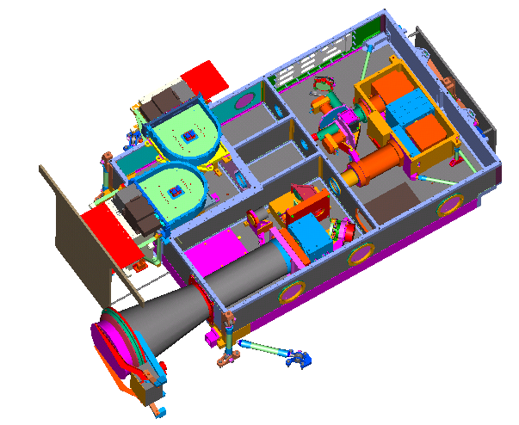
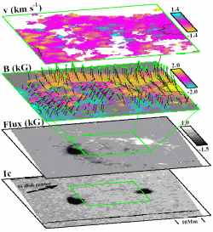
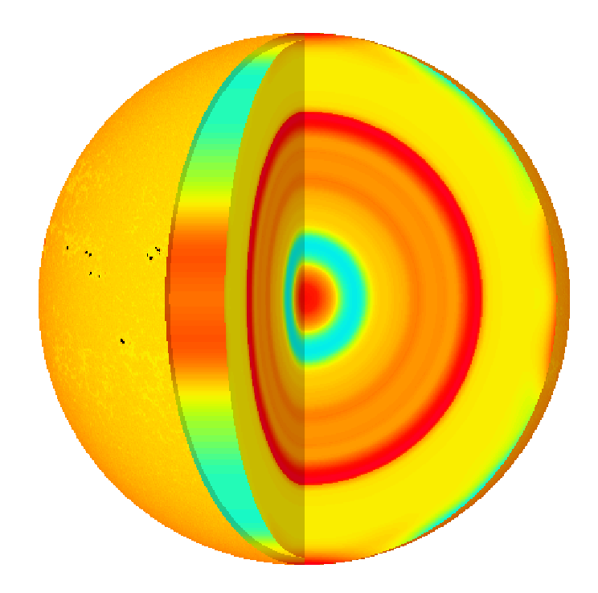
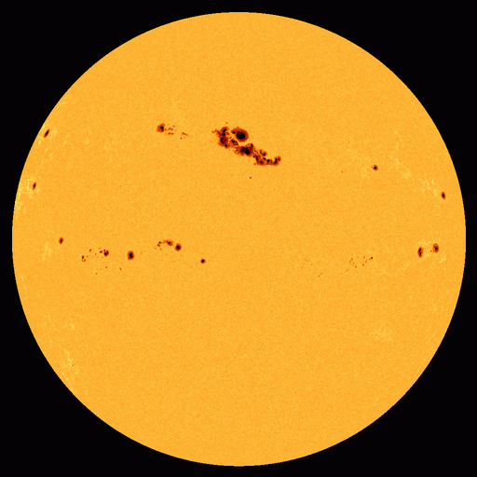
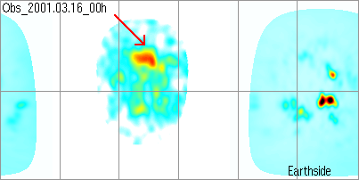
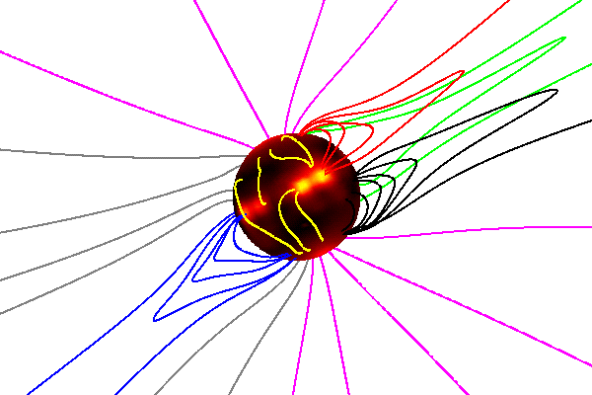
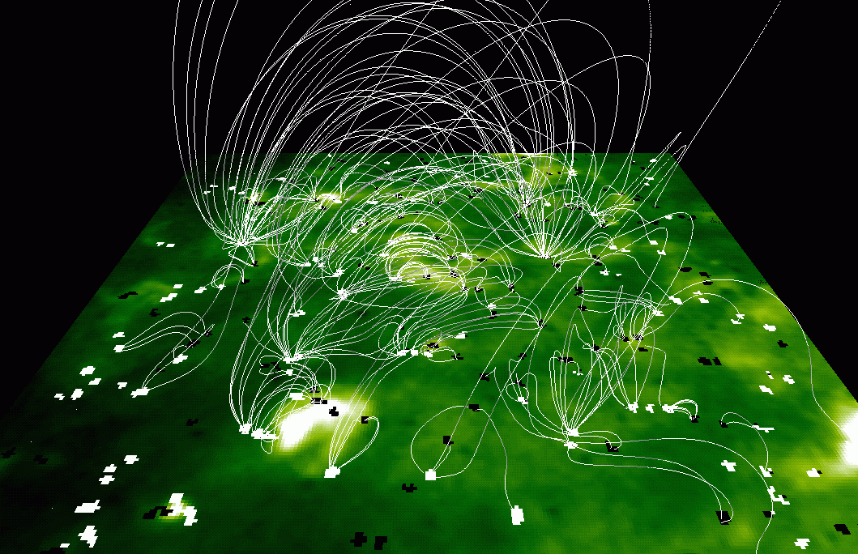
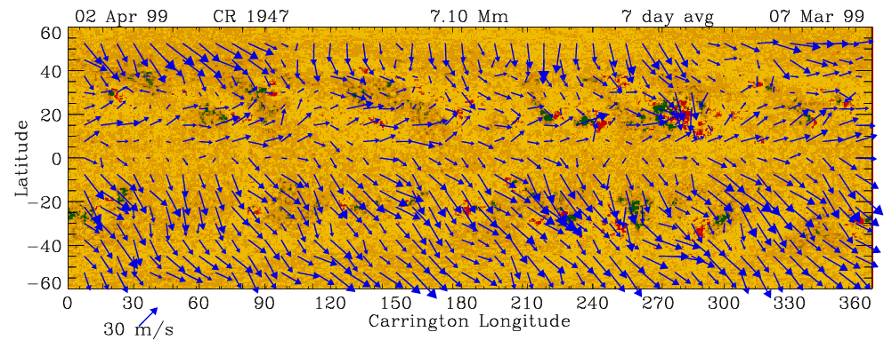
HMI Science: Solar Interior Dynamics and Photospheric Magnetic Fields
Helioseismology is the study of solar interior structure and dynamics via analysis of the propagation of waves through the Sun’s interior.
The Sun is filled with acoustic waves with periods near five minutes. These waves are made by the near surface convection.
The downward propagating waves are refracted upward by the temperature gradient and the upward propagating waves are reflected inward by the drop in density at the surface.
The travel times of these waves depend on the temperature, composition, motion, and magnetic fields in the interior. The visible surface moves when the waves are reflected. HMI measures this motion enabling the wave frequency, phase, and amplitude to be measured.
Analysis of travel times over a multitude of interior paths enables inference of internal conditions.
Solar Magnetic Fields: The Sun is permeated by magnetic fields on multiple scales from “flux tubes” smaller than 70km to 30,000km sunspots to the Sun-covering magnetic network. It is the dynamically changing magnetic fields that is the source of nearly all solar variability that effects the Earth and human technological systems.
HMI will provide the first full-disk continuous observations of solar magnetic fields in all orientations. Prior measurements (e.g. MDI) measured only the component of the field along the line of sight to the observer. The new measurements should improve our understanding of the 3-D structure of the evolving field. We can only measure the fields in the layer of the atmosphere where most all of the light originates (photosphere) and we can then compute estimates of the field in the upper atmosphere where AIA observes the effects of the fields.
How HMI Works: HMI measures a long sequence of Dopplergrams (maps of solar surface velocity) and magnetograms (maps of magnetic field at the Sun’s visible surface, the photosphere.) Each map of motion or magnetic field is computed on the ground from a set of 12 images of the Sun, each obtained with a different combination of wavelength tuning and polarization direction.
The wavelength tuning compared to the chosen solar spectral absorption line is shown in this figure. The black line at the top shows the solar iron spectral line profile. The colored lines show the HMI filter transmission profiles at 7.6 nm tuning spacing. The black
HMI Specifications
Central wavelength | 6173.3 Å ± 0.1 Å (Fe I line)
Filter bandwidth | 76 mÅ ± 10 mÅ fwhm
Filter tuning range | 680 mÅ ± 68 mÅ
Central wavelength drift | < 10 mÅ during any 1 hour period
Field of view | > 2000 arc-seconds
Angular resolution | better than 1.5 arc-seconds
Detector resolution | 0.50 ± 0.01 arc-second / pixel
Focus adjustment range | ± 4 depths of focus
Pointing jitter reduction factor | > 40 db with servo bandwidth > 30 Hz
Image stabilization offset range | > ± 14 arc-seconds in pitch and yaw
Pointing adjustment range | > ± 200 arc-seconds in pitch and yaw
Dopplergram cadence | < 50 seconds
Camera Image cadence | < 4 seconds
Timing | < 1 µs stability, < 100 ms absolute
Science telemetry allocation | < 55 Mbits/s
Instrument design lifetime | > 5.3 years
dashed line is the profile used for the continuum filtergram. A picture is made for each tuning and the results are used to compute velocity and magnetic field strength at each pixel.
The polarization selector needed for magnetic field measurements is a set of waveplates that can be rotated to different angles for detection of different polarization parameters (called Stokes I,Q,U,V)
The wavelength selection and tuning is accomplished with a set of successively narrower bandpass filters. These are the front window, blocking filter, a five element Lyot filter, and two Michelson interferometers. The last three filter stages can be tuned by rotating retarder waveplates. The combination results in a 7.6nm bandpass that can be tuned over 68nm and is centered on the 617.3nm solar line. (1nm = 10Ǻ)
Examples of science data products from SOHO/MDI. Improved versions of these can be made with HMI observations.
J – Sunspot Dynamics
B – Solar Dynamo
C – Global Circulation
HMI Optics Package Principal Components
A. Sound speed variations relative to a standard solar model.
B. Solar cycle variations in the sub-photospheric rotation rate.
C. Solar meridional circulation and differential rotation.
D. Sunspots and plage contribute to solar irradiance variation.
E. MHD model of the magnetic structure of the corona.
F. Synoptic map of the subsurface flows at a depth of 7 Mm.
G. SOHO/EIT image and magnetic field lines computed from the photospheric field.
H. Active regions on the far side of the sun detected with helioseismology.
I. Vector field image showing the magnetic connectivity in sunspots.
J. Sound speed variations and flows in an emerging active region.
Shutter Assembly
Focal Plane Assembly
ISS Beam-splitter Assembly
Limb Sensor Assembly
ISS Electronics Box
Camera Electronics Box
Telescope Assembly
Primary Lens Assembly
Front Door Assembly
Fold Mirror Assembly
BDS Beam-splitter
Michelson Interferometer
Alignment Mechanism
Filter Oven Assembly
Lyot Filter Assembly
Oven Controller E-Box
ISS Mirror Assembly
Focus Mechanism
Hollow Core Motors
Secondary Lens
I – Magnetic Connectivity
A – Interior Structure
D – Irradiance Sources
H – Far-side Imaging
E – Coronal Magnetic Field
Z
G – Magnetic Stresses
F – Solar Subsurface Weather
X
Y
Mechanical Characteristics:
Box: 0.84 × 0.55 × 0.16 m
Over All: 1.19 × 0.83 × 0.30 m
Mass: 44.0 kg
First Mode: 73 Hz
Optical Characteristics:
Effective Focal Length: 495 cm
Telescope Clear Aperture: 14 cm

